Slide 1

CMN 1160A – Introduction to Media Studies
Week 9B: Communications Policy: What is communication for?
Daniel J. Paré
University of Ottawa, Department of Communication
November 3, 2016

Slide 2
Preview
Evolution of Canadian Communication Policy
Public Interest in 2012

Slide 3
Canadian Communication Policy
Pre- 1994/5:
Distinctions between:
Content and Carriage
Different policy and regulatory frameworks according to sector:
Telecommunications (ie. Telephony)
Broadcasting (TV and radio)
The Press
Post-1994/5:
On-going ‘renewal’ process
Debate not focused, but diverse
Politically important issues, but relatively little public engagement

Slide 4
Foundations of Canadian Communication Policy
United Kingdom
Sykes Committee Report, 1923
State should own and operate broadcasting system
Non-profit & non-commercial
Give public what ‘we’ think it needs, not what they want
Public control = Direct control by the State
United States
U.S. Radio Act, 1927
Broadcasting infrastructure should be privately owned, BUT State should regulate broadcasting system
for profit & commercial
What interests the public is the public interest
Public control = Oversight of broadcasting system by the State

Slide 5

Foundations of Canadian Communication Policy
1920s:
Key Policy Questions:
What to do with radio?
How to structure the broadcast system?
Who should ‘police’ the broadcast system?
Key Issues:
American presence on airwaves
Limited number of frequencies
Urban concentration of radios
Mediocrity of programming
Cultural production for internal purposes

Slide 6
Aird Commission 1929
Defining Features:
Purpose of broadcasting = “to inform, to educate, and to entertain”
Broadcasting has national purpose
Broadcasting policy = national policy
Public corporation independent of government control by definition (i.e. NOT a state broadcaster)
Recommendations:
Need some form of public ownership, operation and control
Establish high power stations across Canada
Establish national company to produce programs of ‘high standard’
Finance with license fees
Provinces to control programming of station(s)

Slide 7
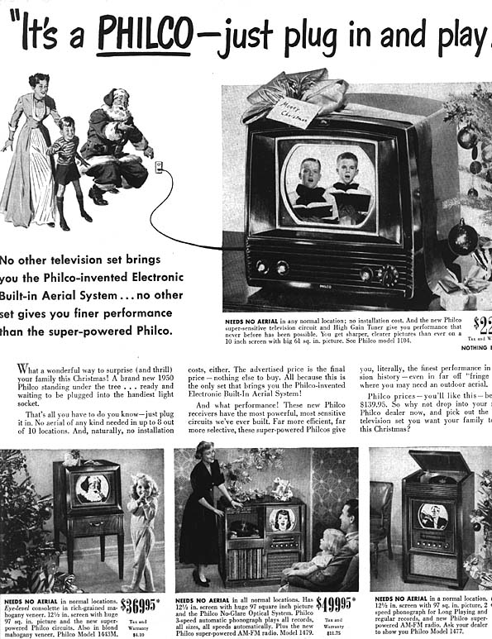
Enter Television, 1949-1958
1950s:
Key Policy Questions:
What to do with TV/radio?
How to structure the broadcast system?
Who should ‘police’ the broadcast system?
Key Issues:
American presence on airwaves
Limited number of frequencies
Technical standards to adopt for TV
Underdeveloped private production sector
Cultural production for internal purposes

Slide 8
The Massey-Lévesque Commission, 1949–51
Commissioners called to report on six areas:
Operation and development of agencies such as the NFB, National Gallery, etc.
Relations with UNESCO and other international bodies
Relations between government and national voluntary associations
Methods to spread knowledge of Canada abroad
Measures to preserve historical monuments,
‘Principles upon which the policy of Canada should be based, in the fields of radio and television broadcasting’

Slide 9
Massey-Lévesque Commission, 1951
Defining Features:
Culture as an element of ‘national defence’.
Institutions not under state control potentially harmful to Canada (e.g., film industry).
Media as tool for building national identity through cultural production.
Regional differences = risk to national unity.
Recommendations:
Favourable view of CBC programming; Critical of private broadcaster programming (but service to public justifies their existence)
Government to play greater role in nurturing cultural and intellectual activity
No separate regulatory body needed
Full scale inquiry of TV three years after its inception

Slide 10
Fowler Commission, 1955-1957
Mandate:
Recommend policy for TV including measures for:
ensuring sufficient Canadian programs for public and private broadcasting
licensing and control of private stations
financial management requirements of CBC
2 Principles to Uphold:
granting broadcast channels remains under control of Parliament
central feature of broadcasting policy remains “broadcasting and distribution of Canadian programs by a public agency”

Slide 11
Fowler Commission, 1955-1957
Recommendations:
mixed system of public and private ownership
CBC’s statutory broadcast functions be separated from its broadcast regulation functions
Private broadcasters’ performance to be evaluated
Creation of independent public body to regulate broadcasting in the public interest
Foreign ownership restrictions on private broadcasters
Federal funding for CBC
Establishment of Canadian content quota - 45 % of programming on TV must be "Canadian in nature"

Slide 12
The Applebaum-Hébert Committee, 1981/2
Mandate:
review cultural policies for Canada - all main programs of the Federal Government’.
propose improved means of administering arts funding
Features:
Increased acceptance of private sector
Reject protectionist stance of previous Commissions – emphasize need to promote Canadian products , rather than blocking American content.
State as patron/catalyst instead of regulator of culture

Slide 13
The Applebaum-Hébert Committee, 1981/2
Recommendations:
Reorganization of the Canadian Broadcasting Corporation
relinquish all television production activities and facilities – acquire program materials from independent production companies
Need to improve the economic status of artists,
Strengthen Canadian content regulations in radio programming.
Provide government assistance to Canadian-owned companies to distribute and market recordings of pop music and specialized materials recorded by Canadian artists

Slide 14
Communication Policy Objectives
Phase 1: (1840s-1930s):
Ad-hoc policy – few ‘communication’ goals
Policy centered on emerging technologies (telegraph, telephone, cinema, radio)
Separation of regulatory regimes (content vs carriage)
Newspapers the only ‘political’ medium

Slide 15
Communication Policy Objectives
Phase 2: (1945-1980):
Government intervention in communication markets for social purposes accepted
Policy dominated by socio-political concerns (national interest and nation building)
Broadcasting (TV and radio) emphasis on public service goals (i.e. community and nation building)

Slide 16
Communication Policy Objectives
Phase 3: (mid-1980s onward):
Age of ‘deregulation and liberalization’ AND convergence
Government intervention in communication markets increasingly challenged
Competition regulations becoming main vehicle for overseeing electronic communication market

Slide 17
Greater or Diminishing Need for Regulation?
1. Case for ‘light touch’ regulation:
- Stimulate market-led innovation
- Markets are competitive
- Consumers have choices and alternatives
2. Case for regulatory intervention:
- Market power exercised by key players
- Citizens/Consumers being disadvantaged
- Need to protect broader public interest (including interests of citizens)

Slide 18
‘Public Interest’ in 2016?
Merging of economic and political perspectives?
1. Competitive business environment = public interest?
2. Economic efficiency and promotion of innovation = public interest?
3. Consumerism = citizenship?

